Slide 1



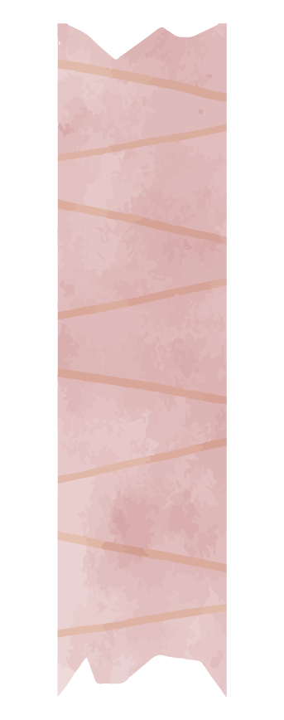
Educational Influences Timeline
By Georgina Wilson

Slide 2



Table of contents
01.
02.
Primary School
Elementary School
03.
04.
High School
University
Lions Bay
Gleneagles
Rockridge -> Workforce
Thompson Rivers University / Volunteering

Slide 3
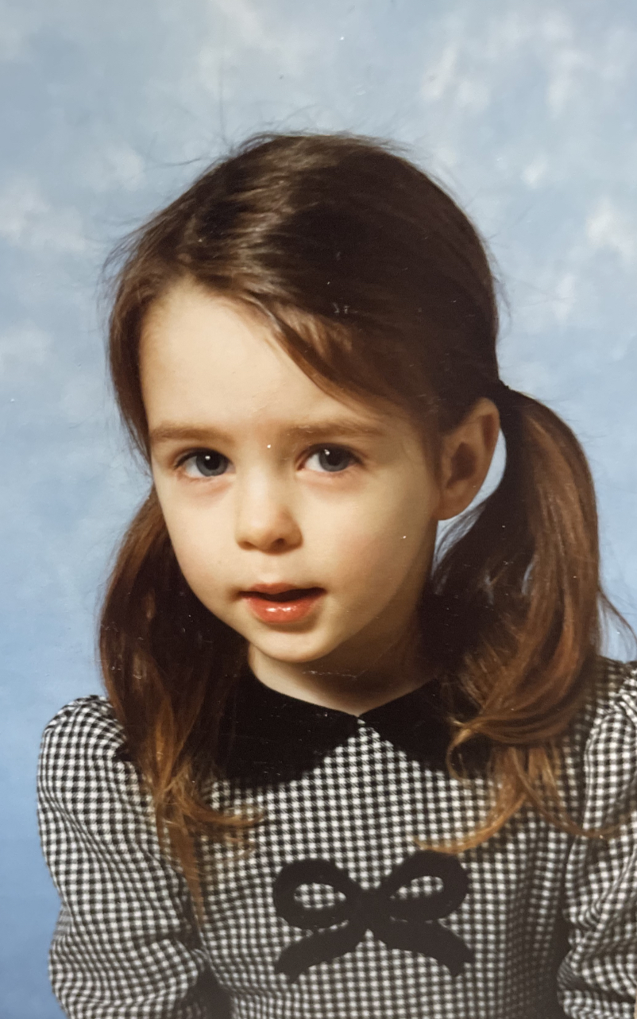

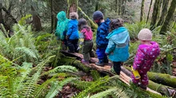
Lions Bay Primary School
33 Kindergarten through Grade 3 students
In a coastal forested area that encourages a natural outdoor learning classroom
Small close-knit community

Slide 4
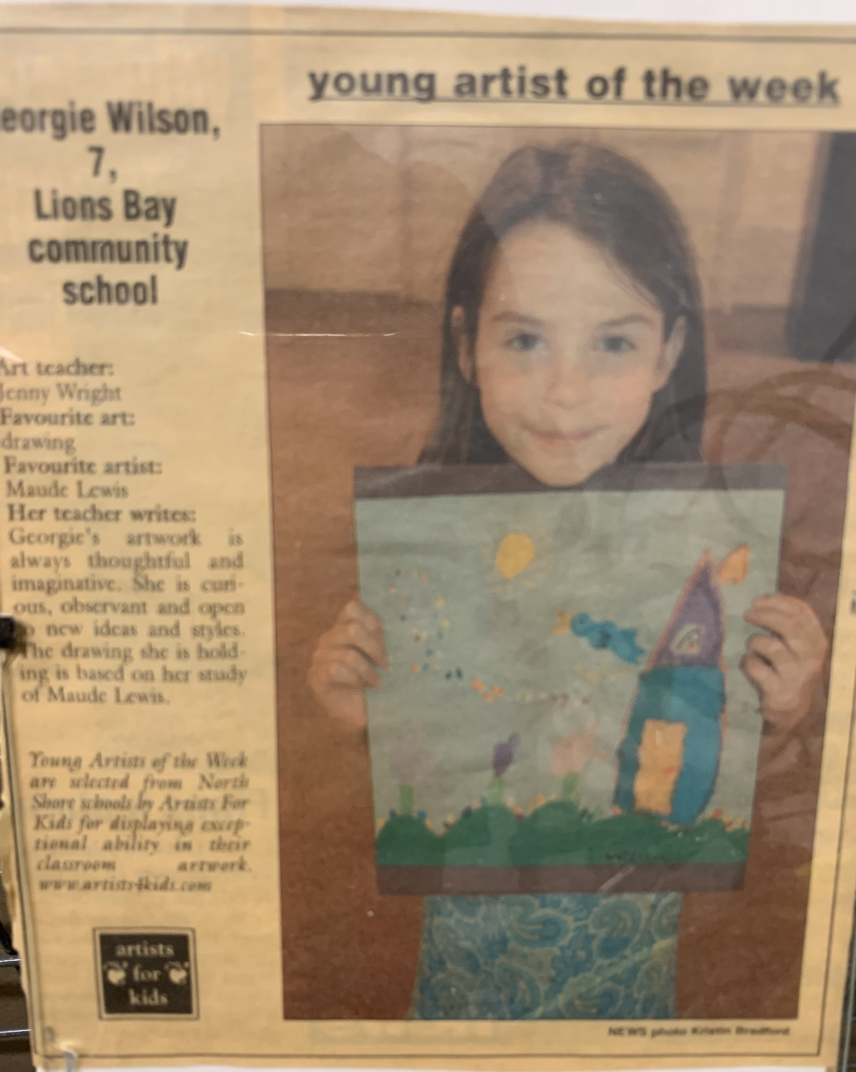
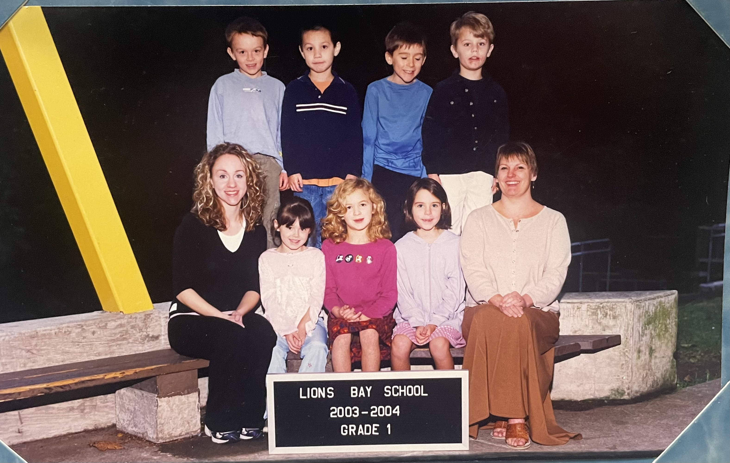


Grade 1
Teacher’s words are very powerful

Slide 5
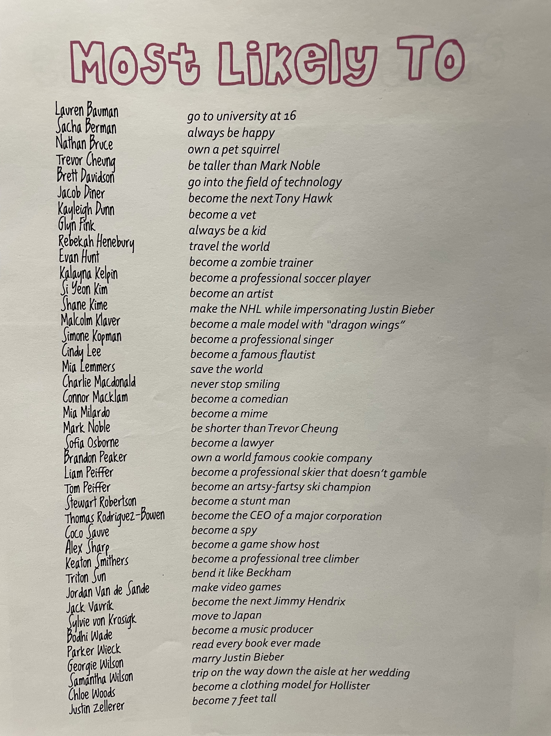

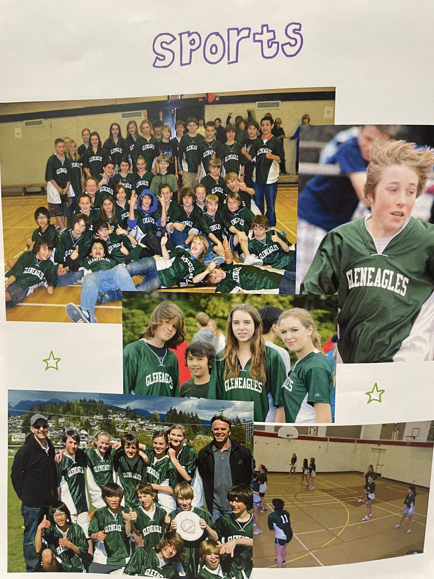
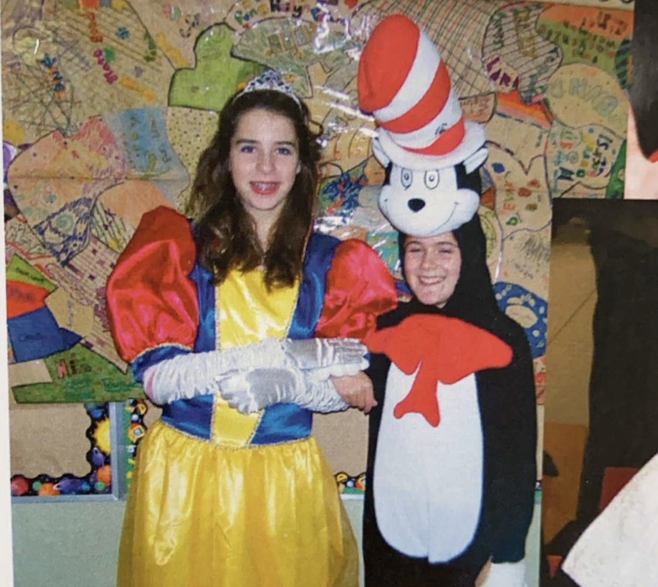
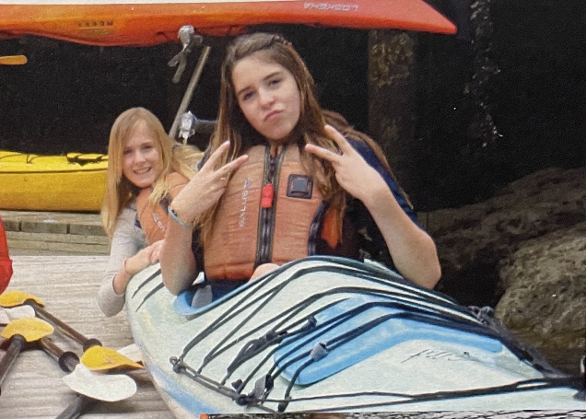
Elementary School
Grades 4-7
● Friendship
● Summer camp
Sports Day

Slide 6

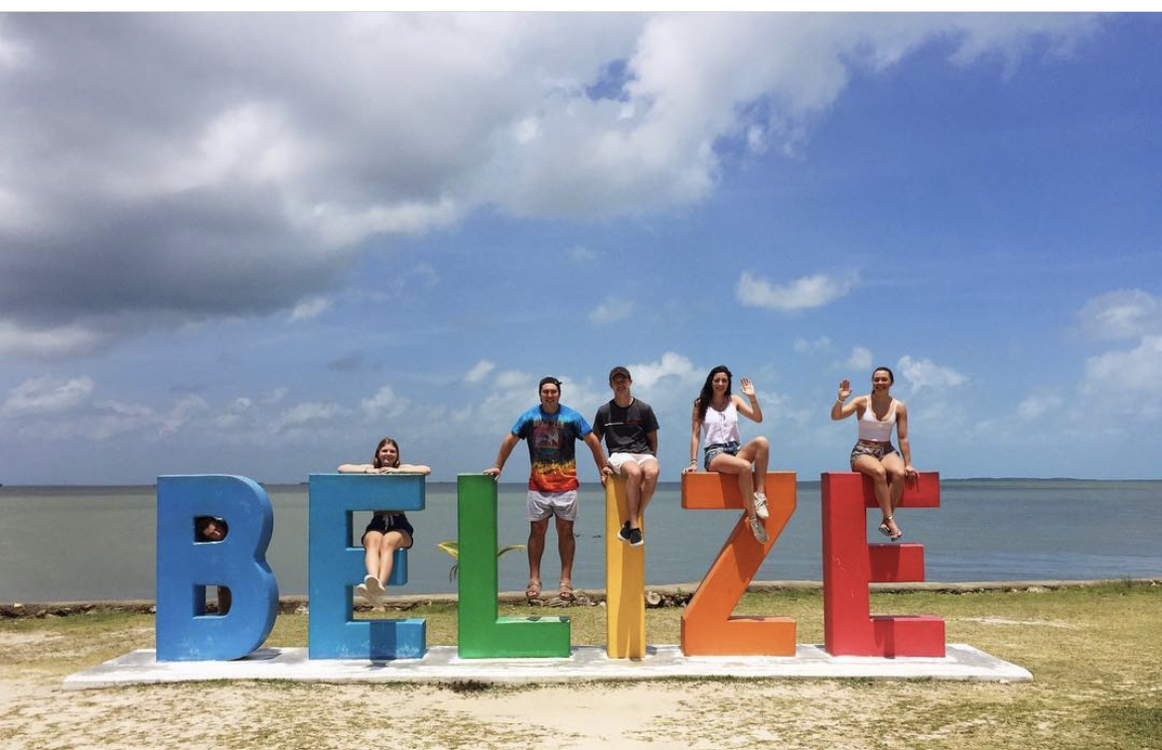

Elementary School Cont.
In grade 6 I lived in Belize for 3 months.

Slide 7
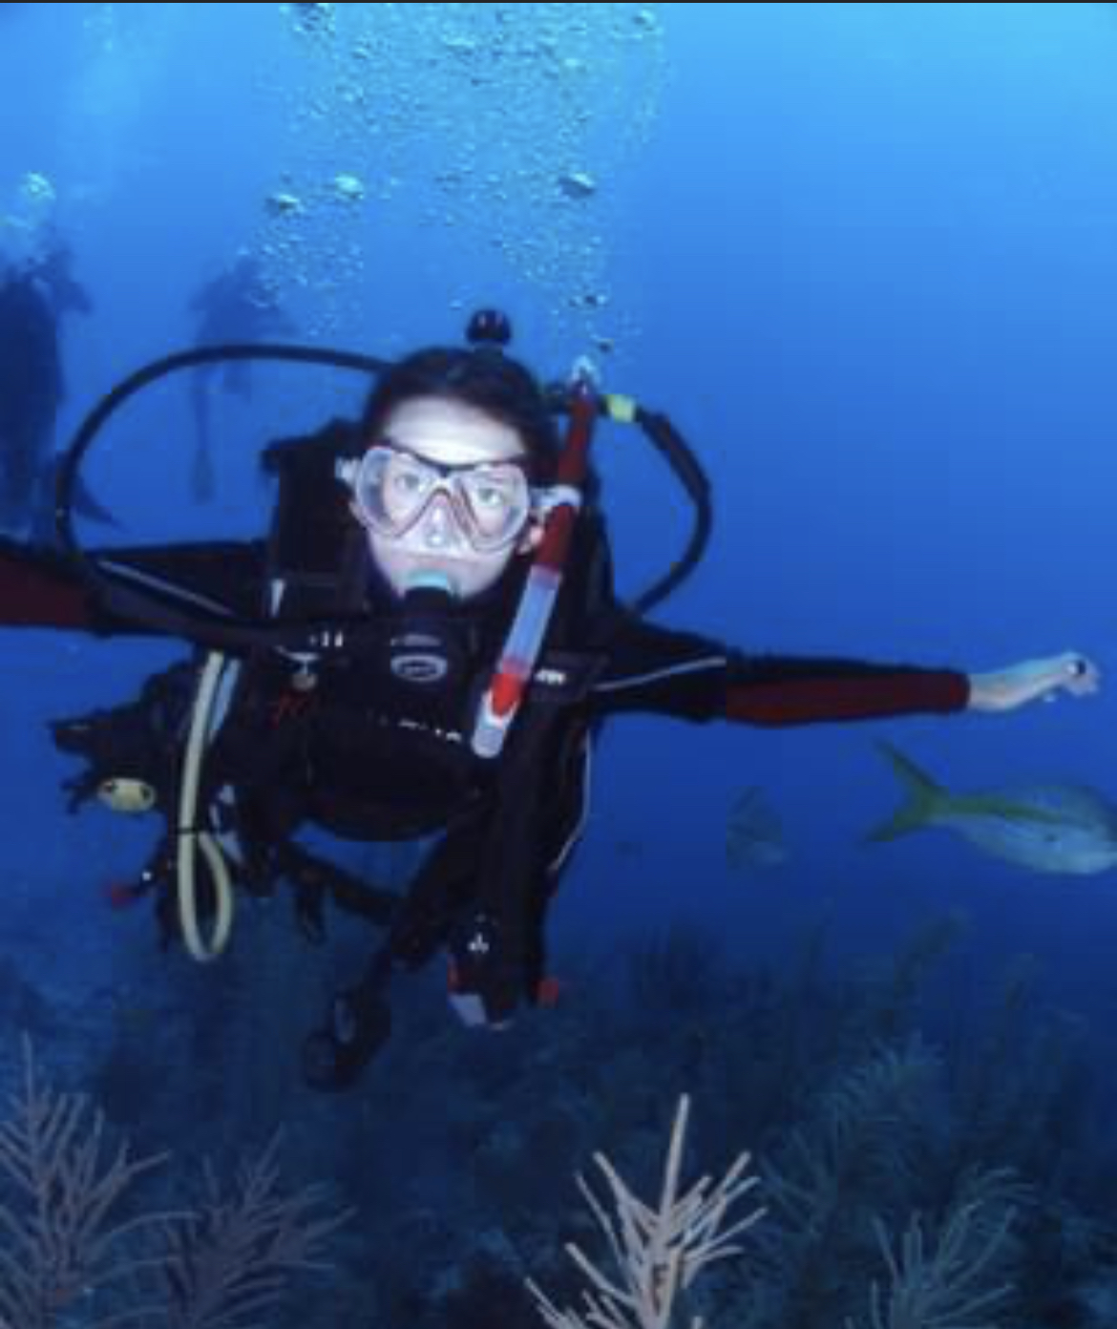
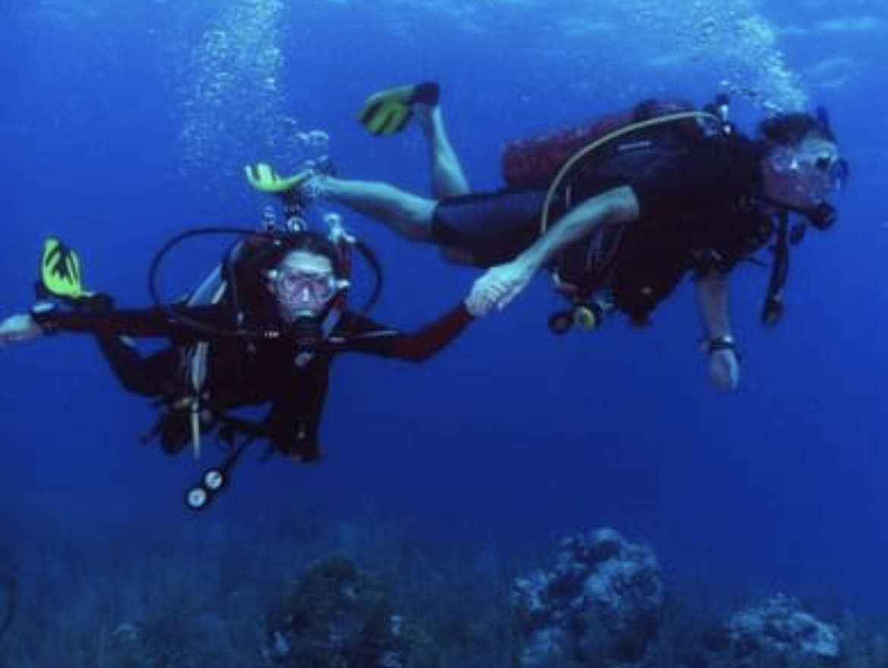
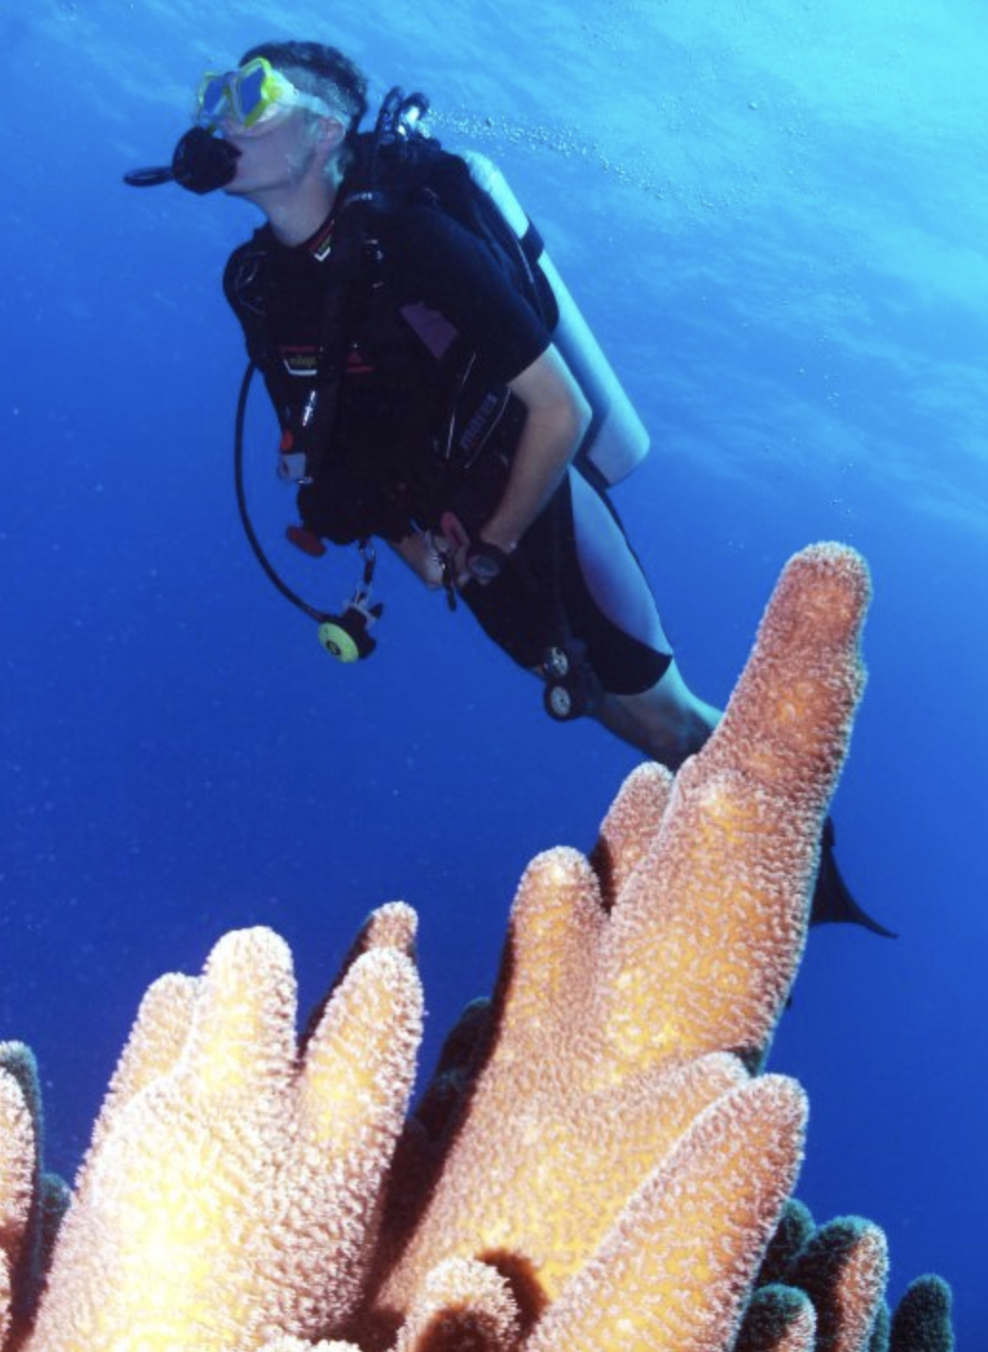
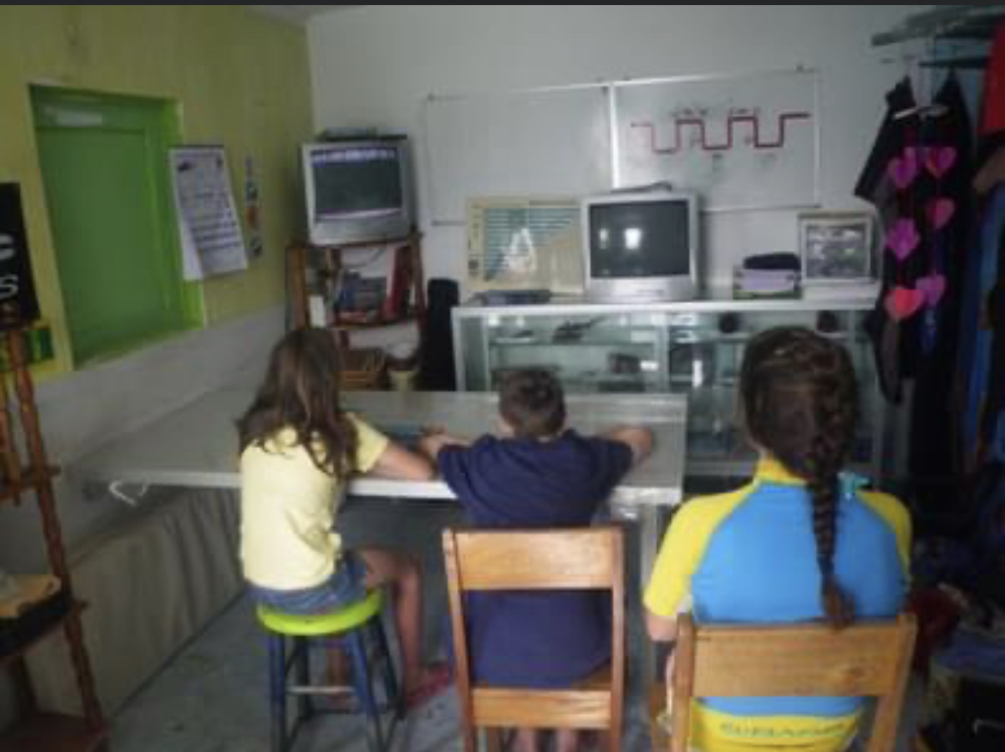
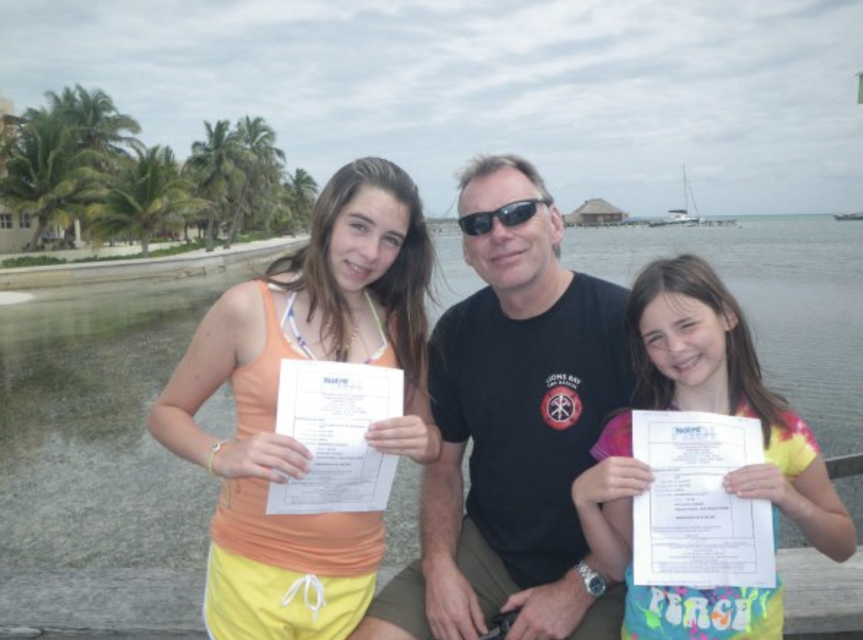

Slide 8
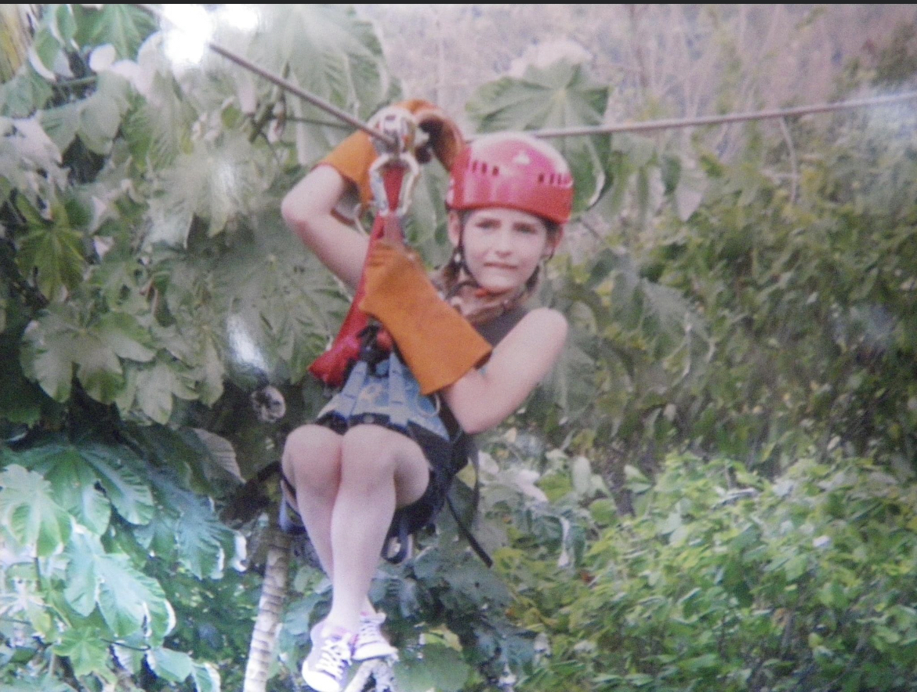
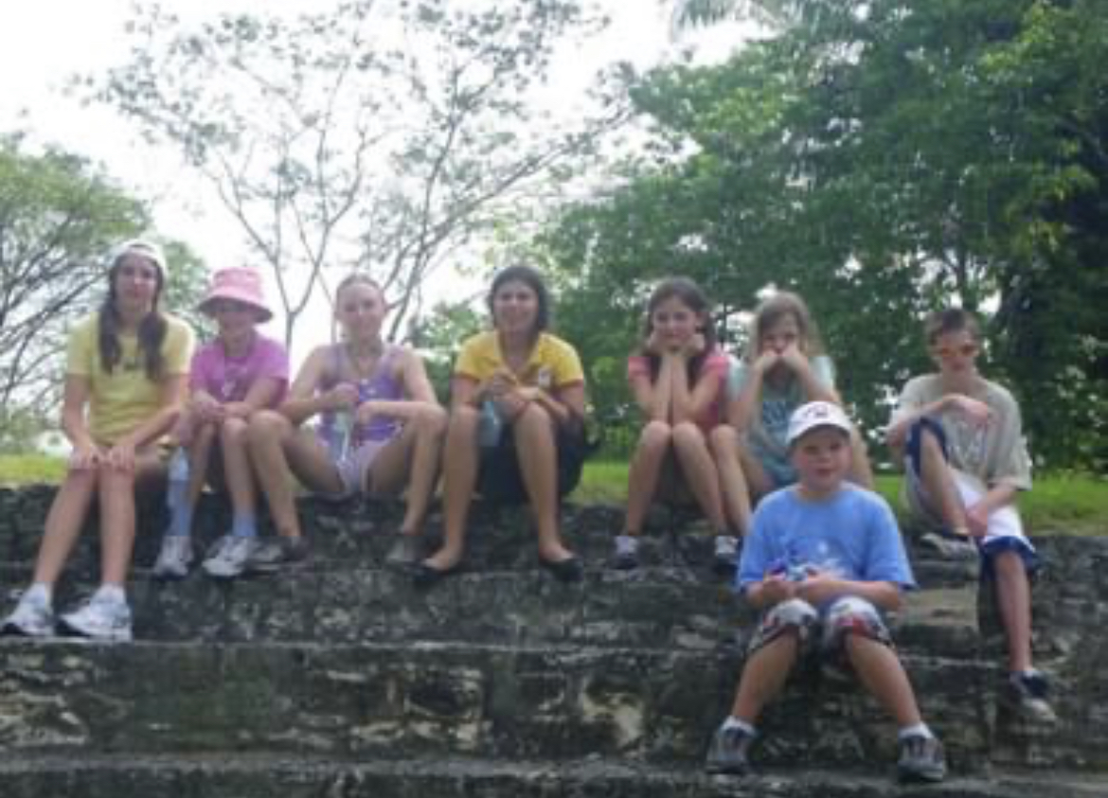
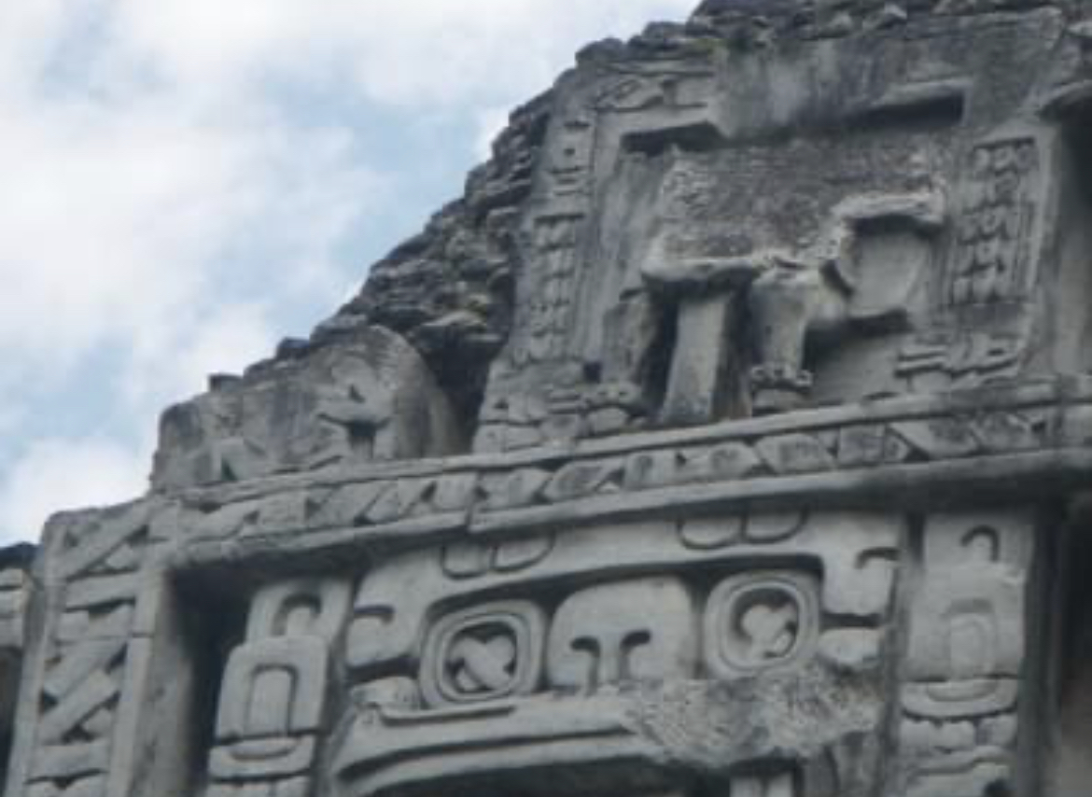
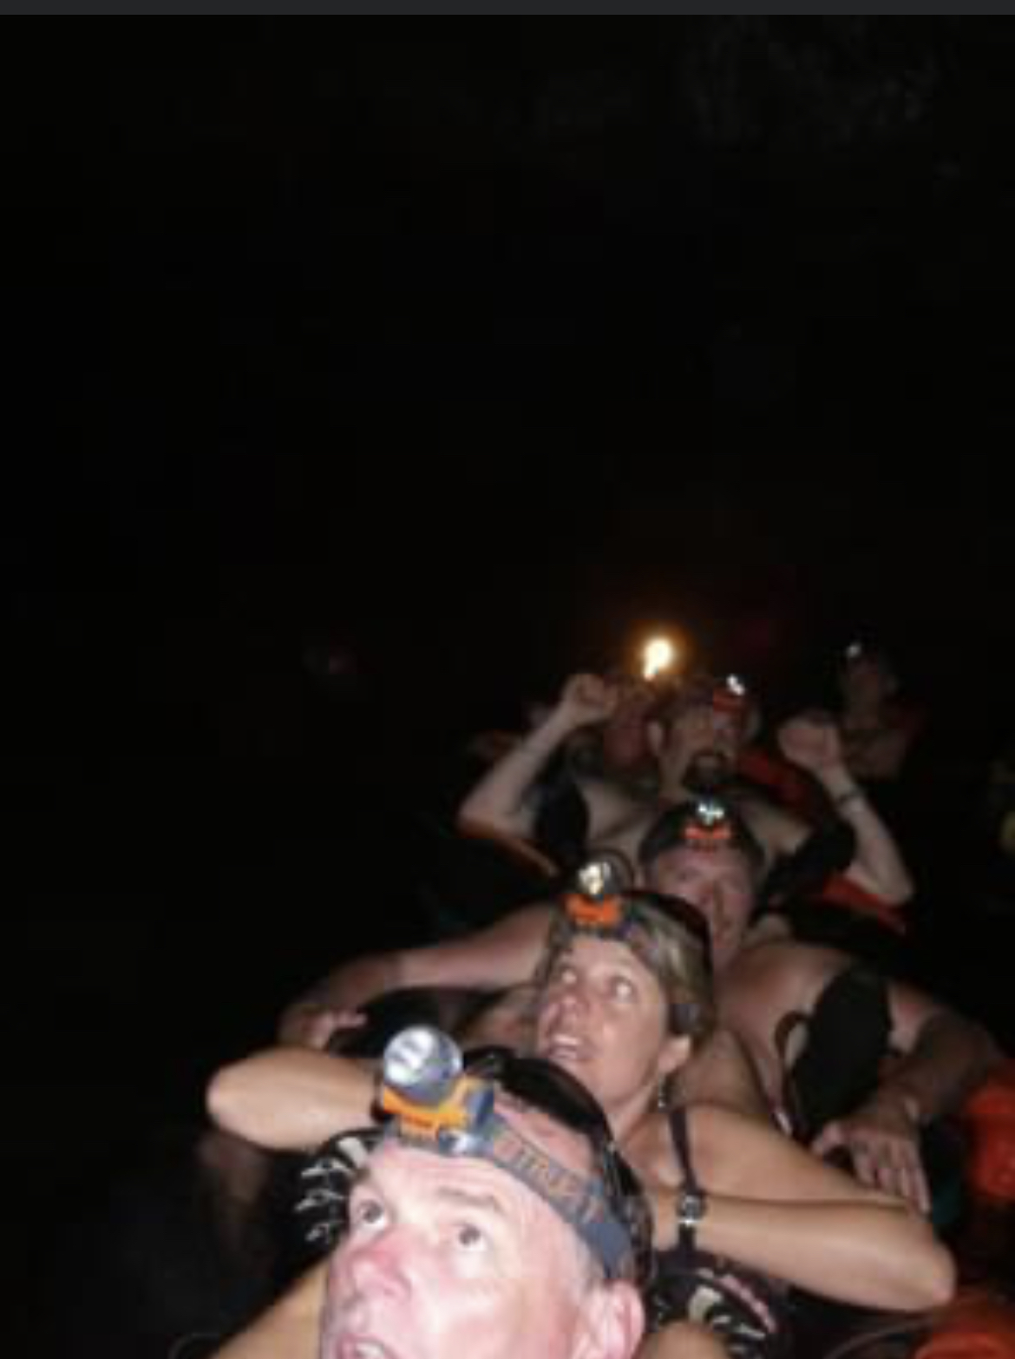
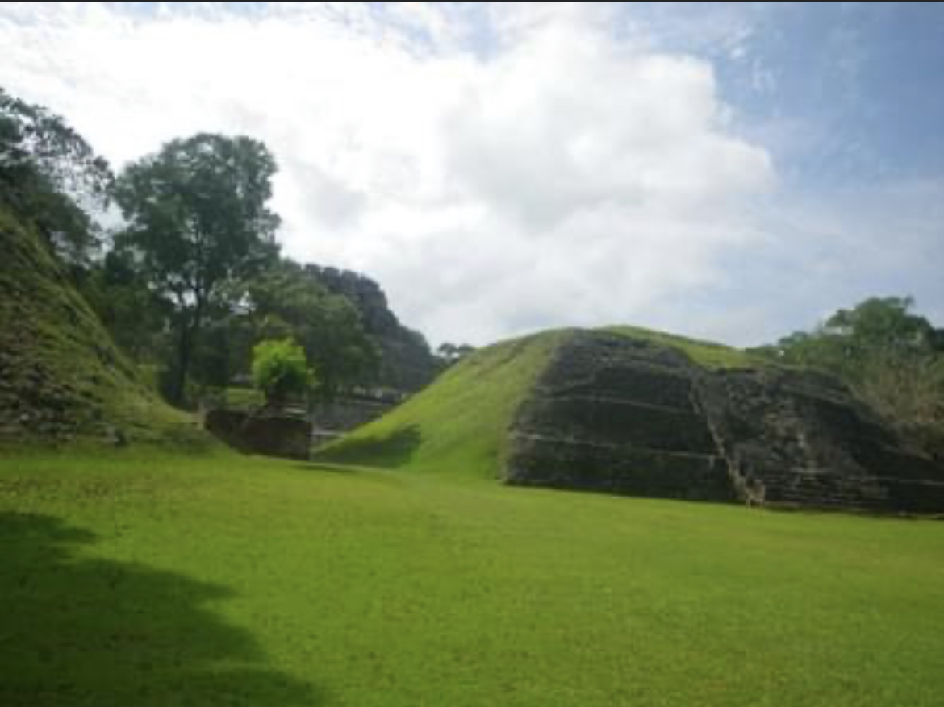
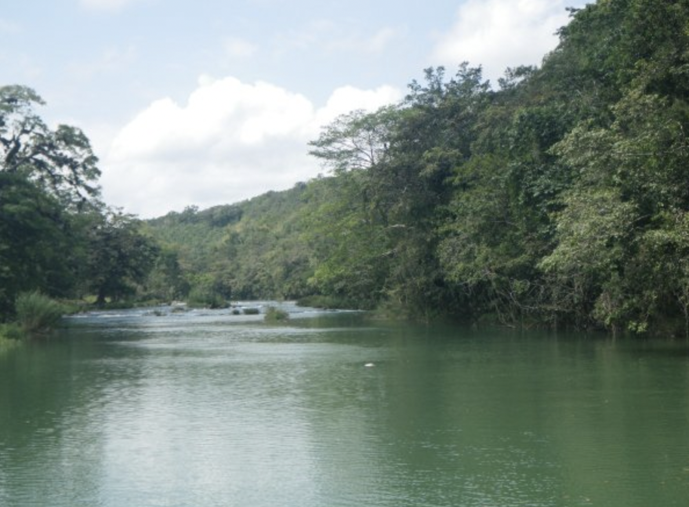

Slide 9
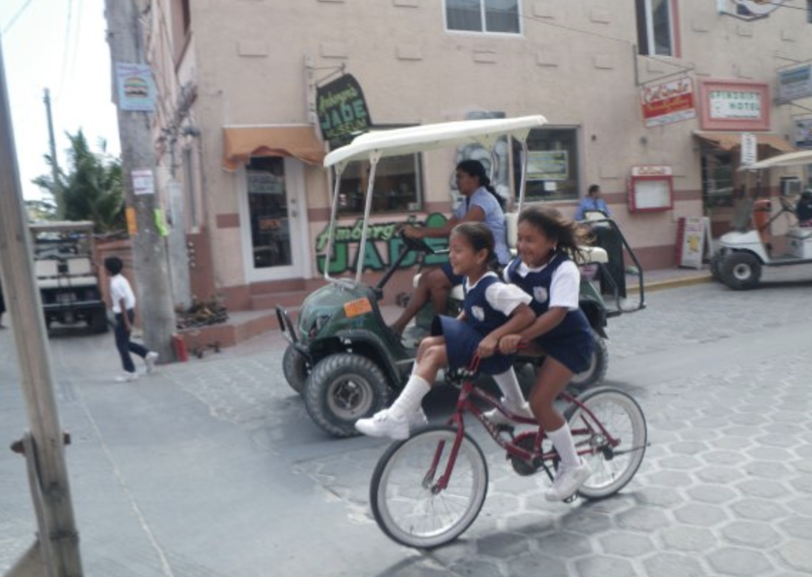
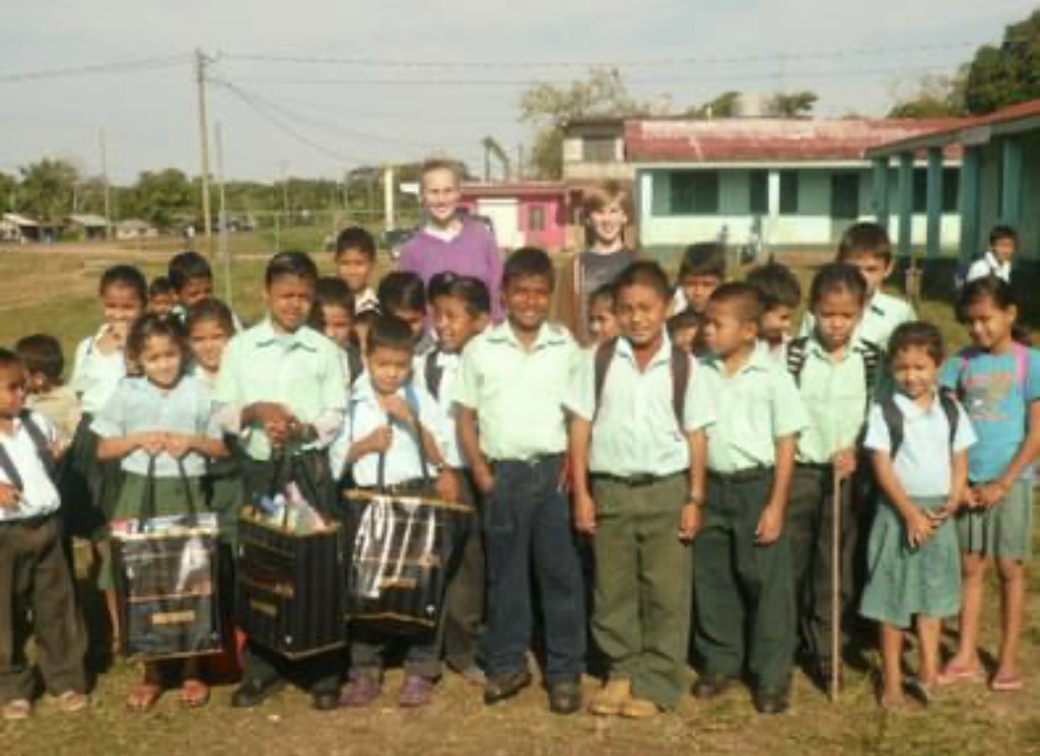
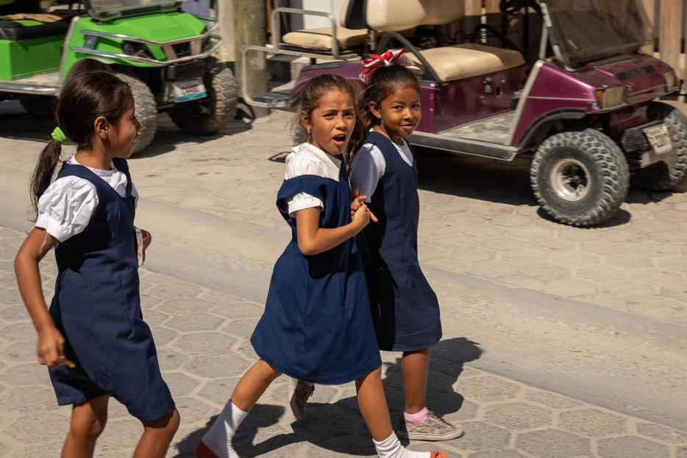
It was a very eye-opening experience visiting a local Elementary School.
I was inspired to become a teacher in developing countries.

Slide 10
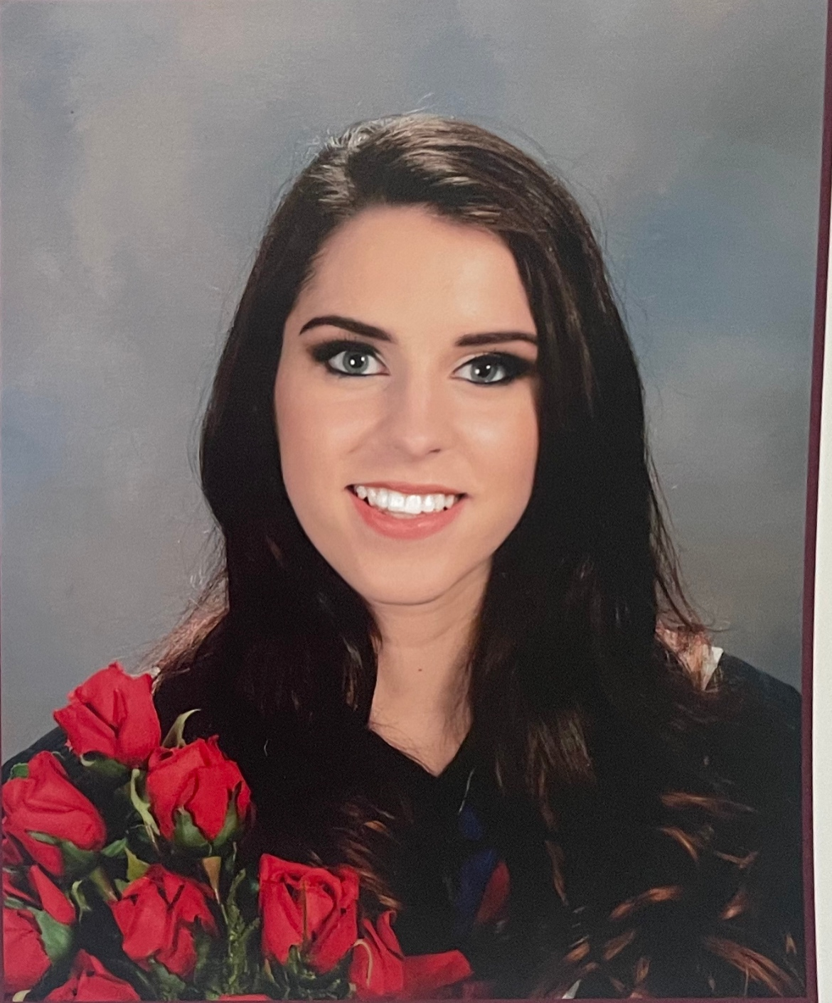

High School
Rockridge Secondary School
Grades 8-12
The only classes I enjoyed were P.E. and art

Slide 11
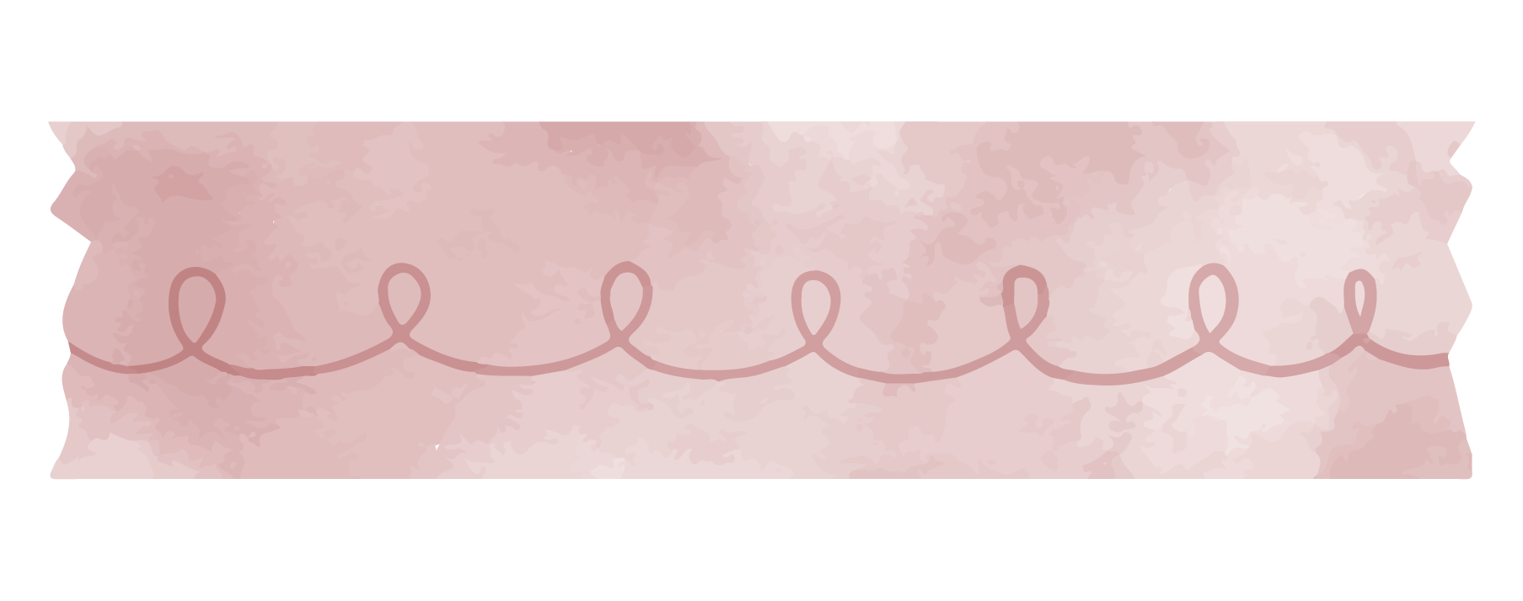

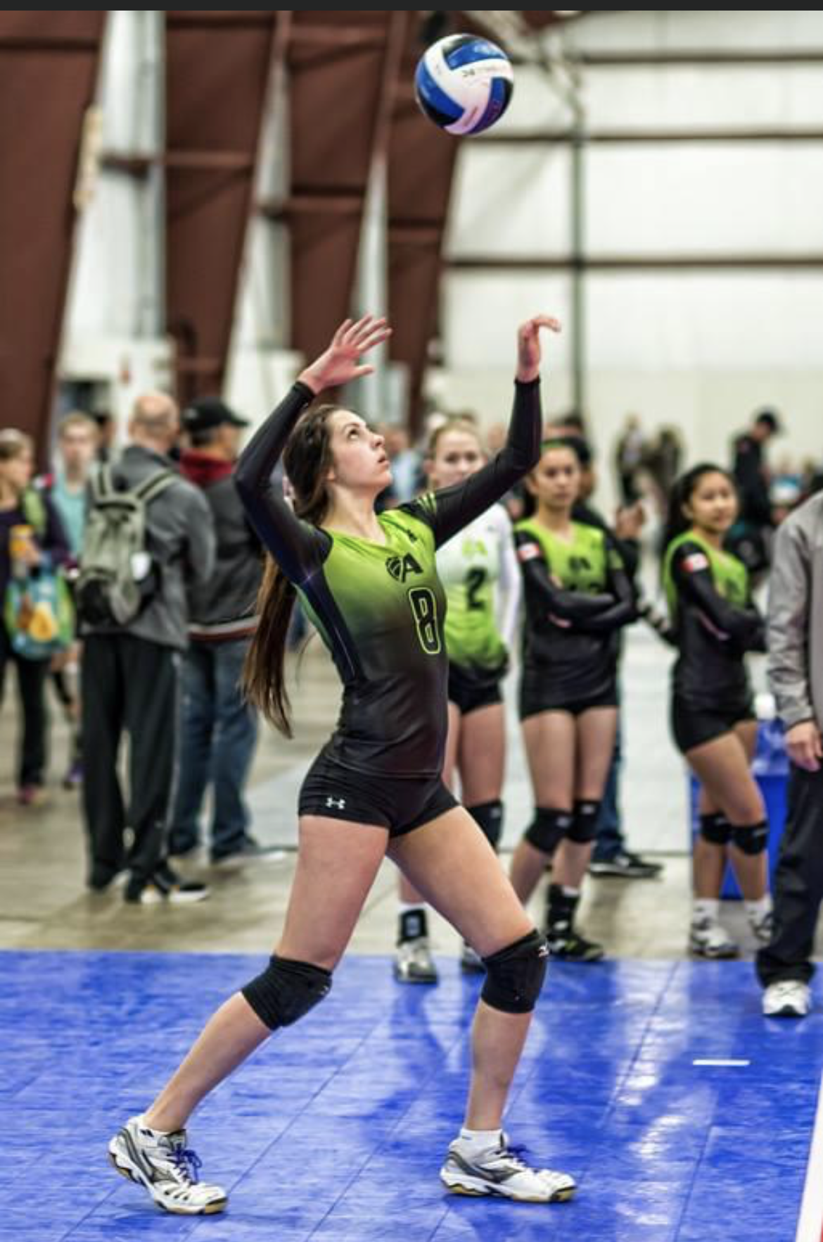

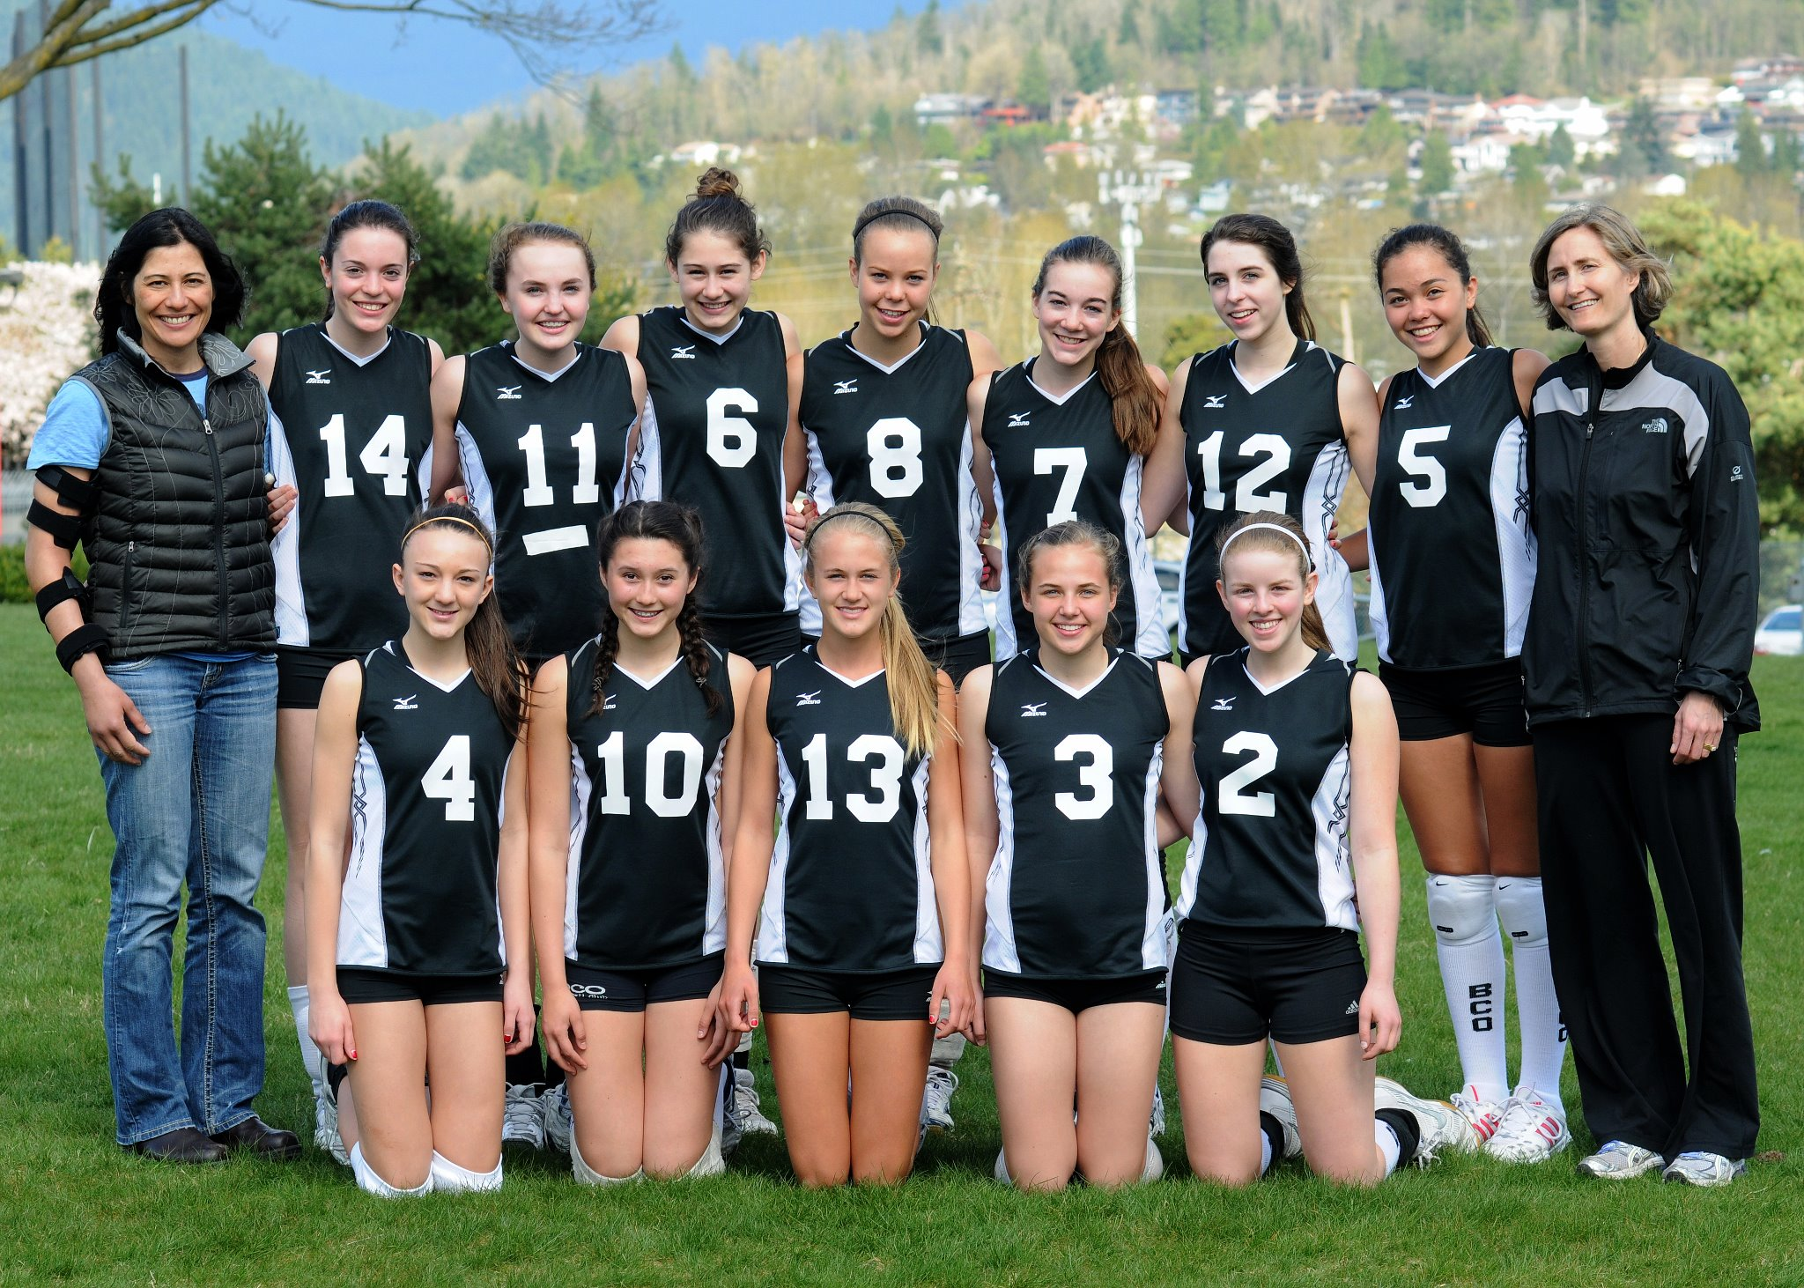

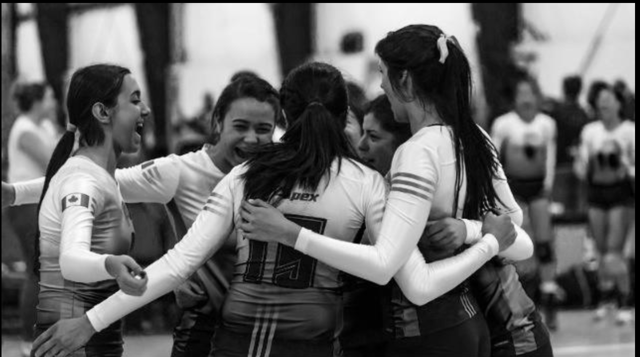


Super Achiever
Volleyball Canada Centre of Excellence
Taught me teamwork skills, and dedication

Slide 12
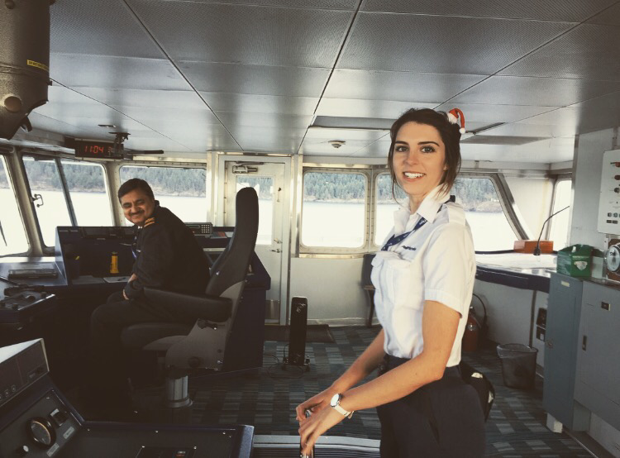
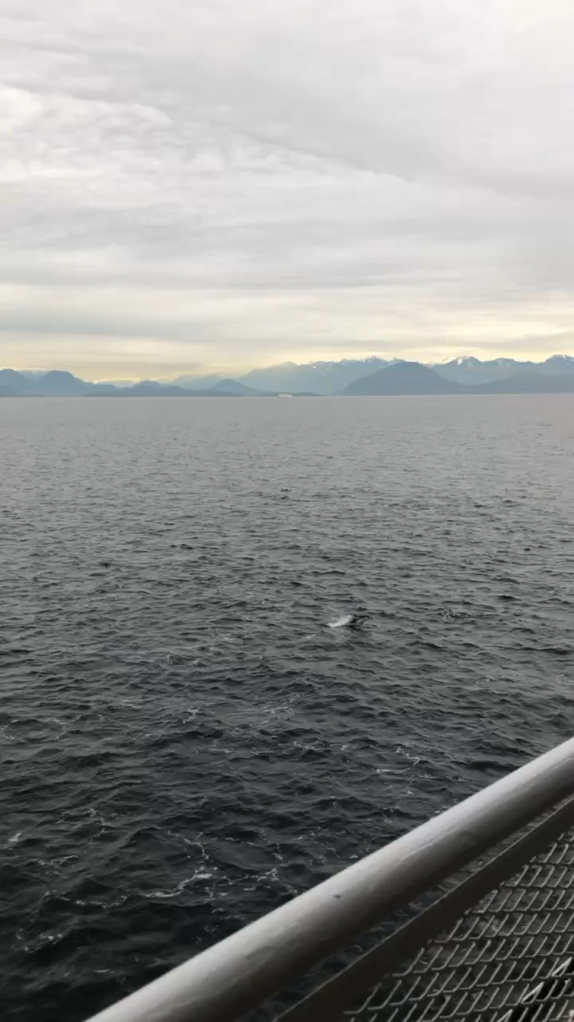

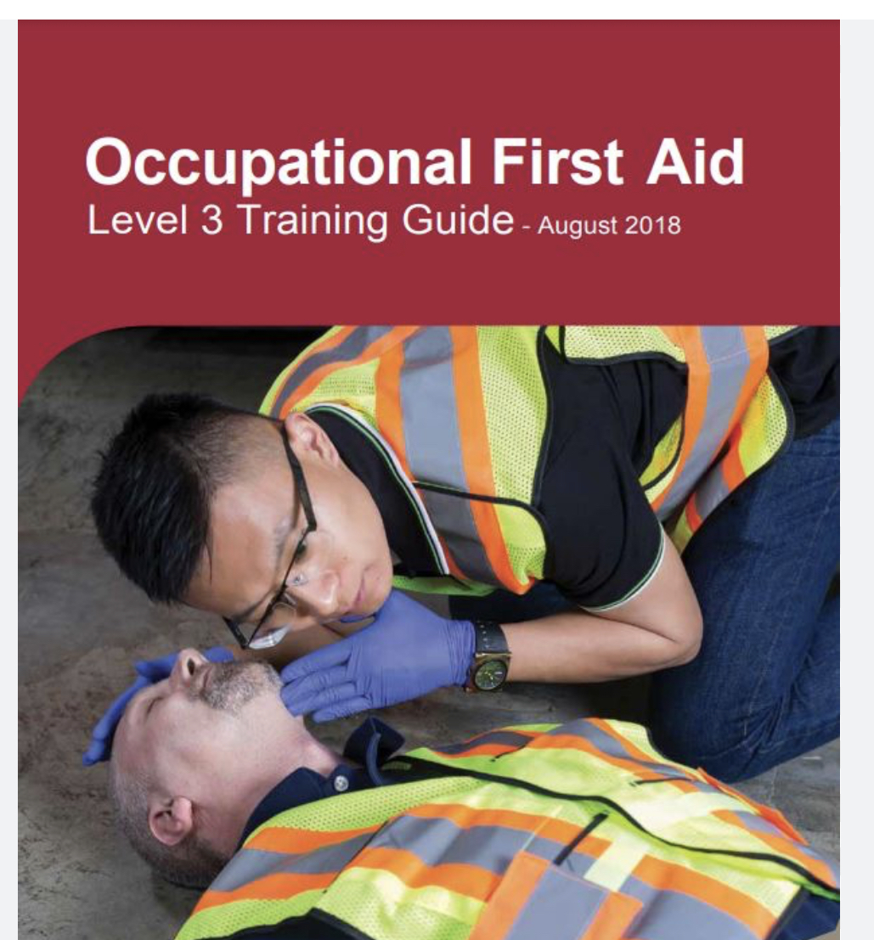
Work
Took 5 gap years after high school.
BC Ferries
OFA 3 Attendant/ CSA
An abundance of marine life

Slide 13
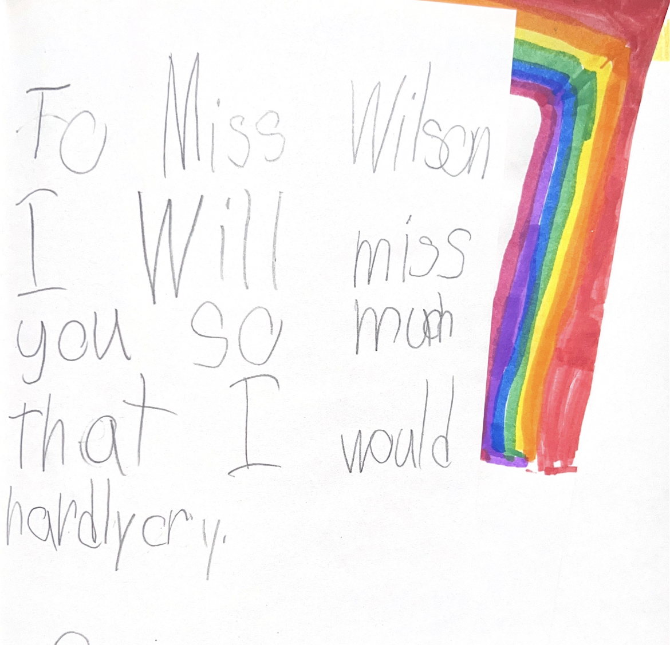
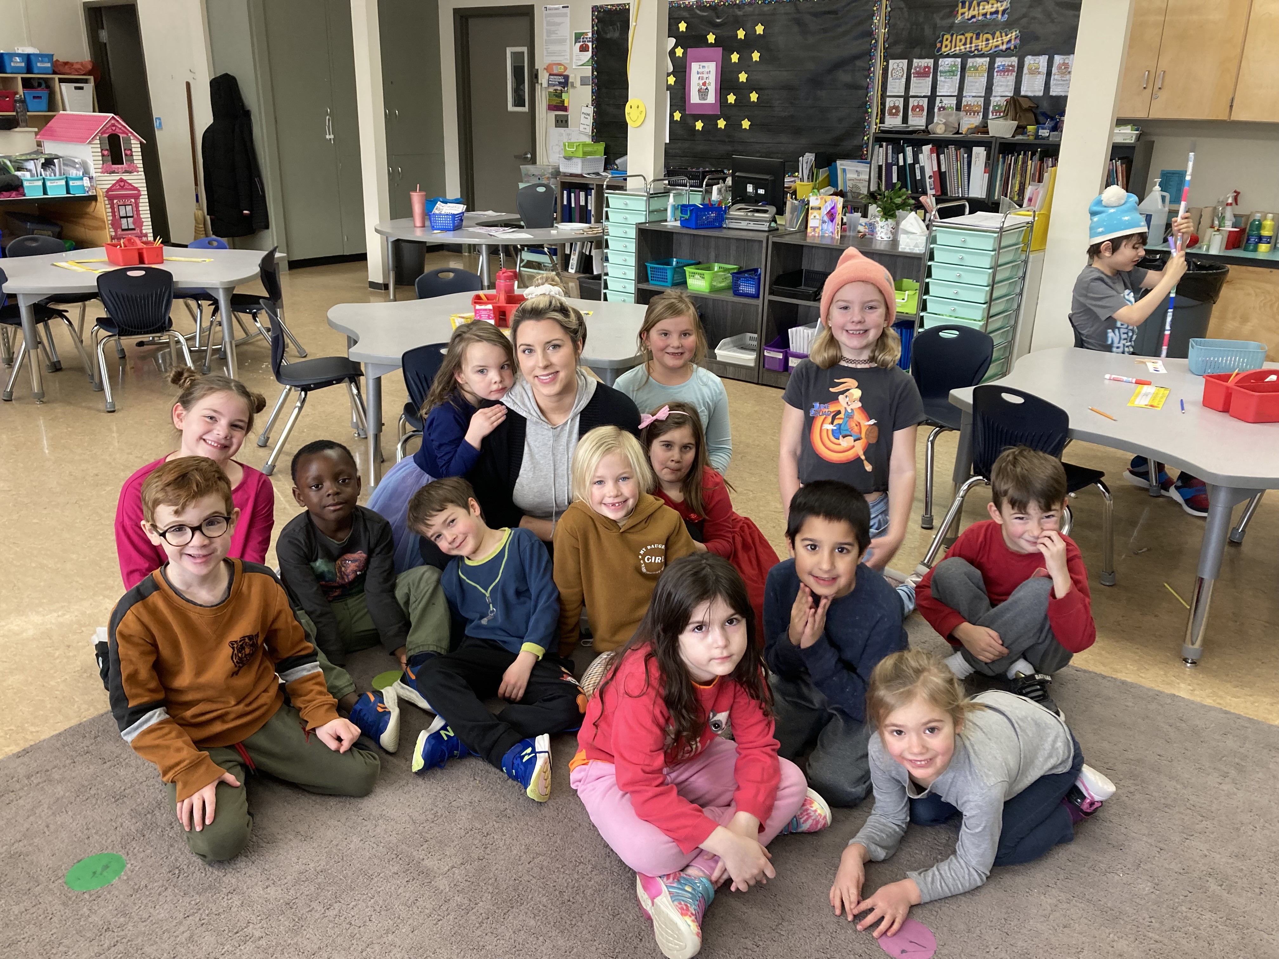
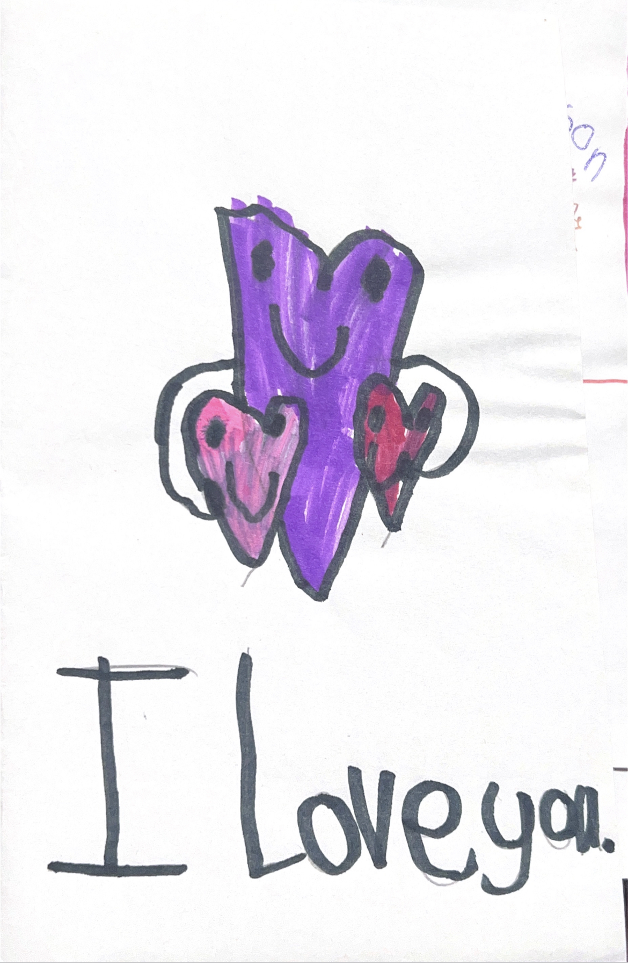
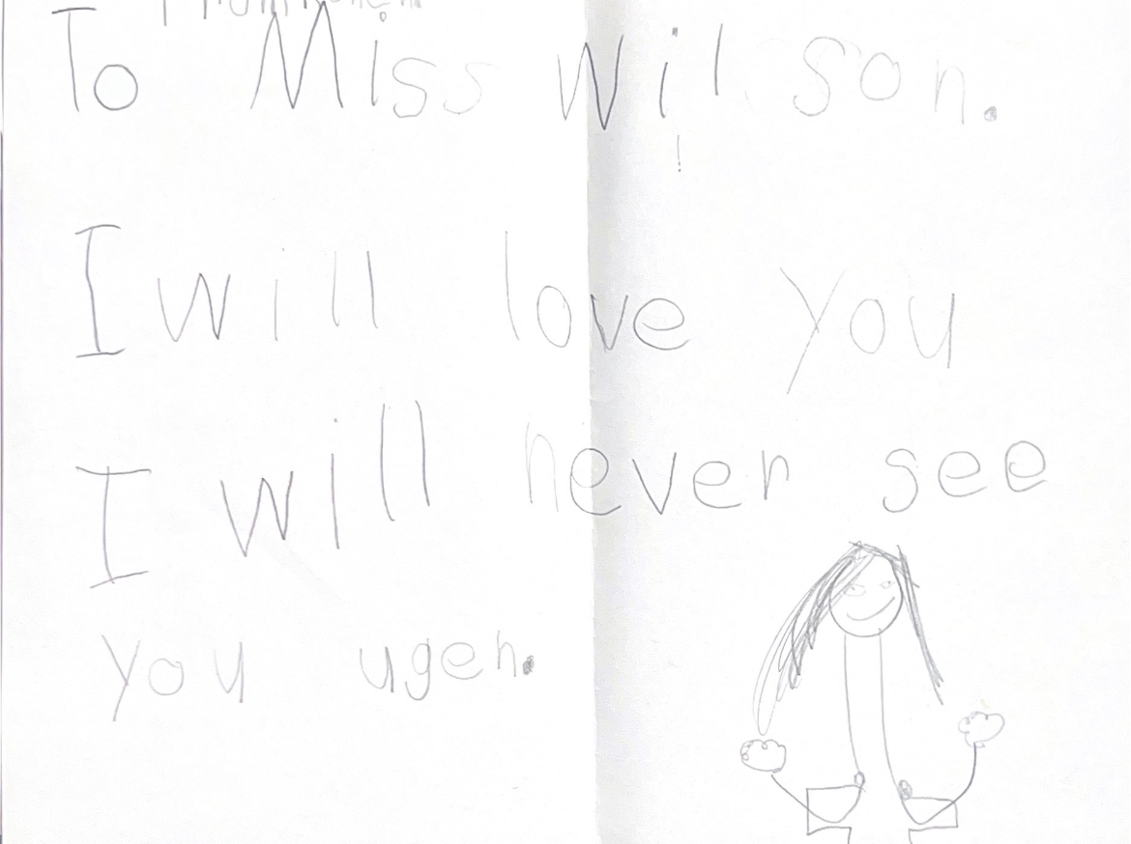
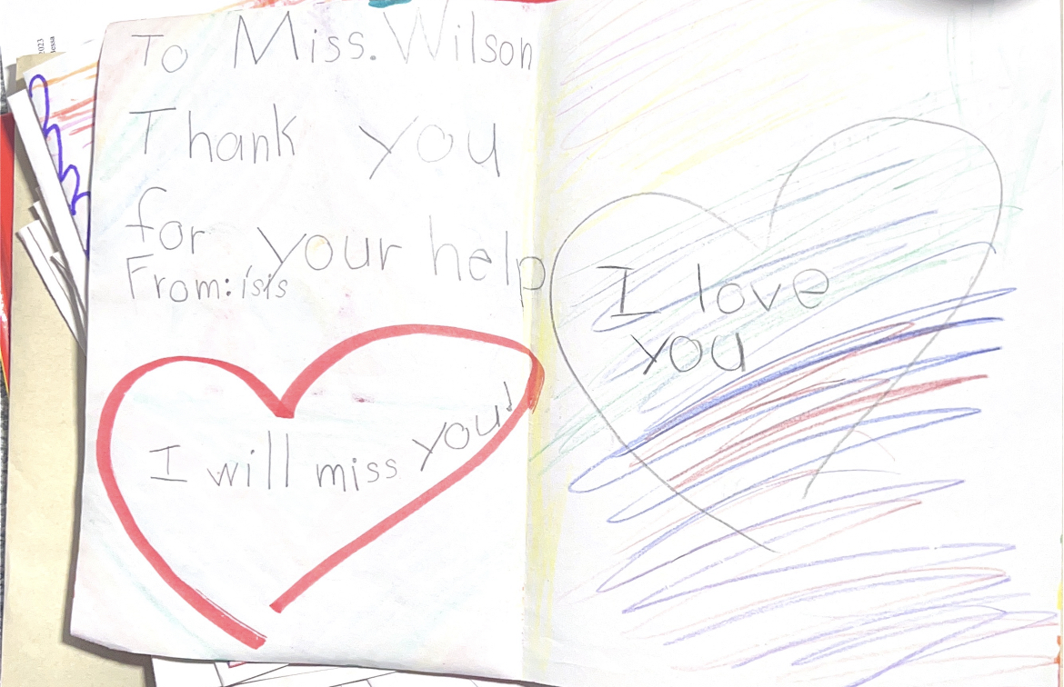
Volunteer Hours
Volunteered at Parkcrest Elementary School.
Assisted in reading and helping with assignments such as journal entries.
Although I was intimidated at first and unsure of myself, I soon fell in love with it, and it solidified my passion for teaching.
Only spending two days a week for a few hours there, it did not seem that I had much of an impact, but having the students run to greet me when I walked in and give me a hug shouting "Ms. Wilson!!!" and writing me goodbye letters was the best feeling in the world, and I can't wait to be a teacher in the future.

Slide 14
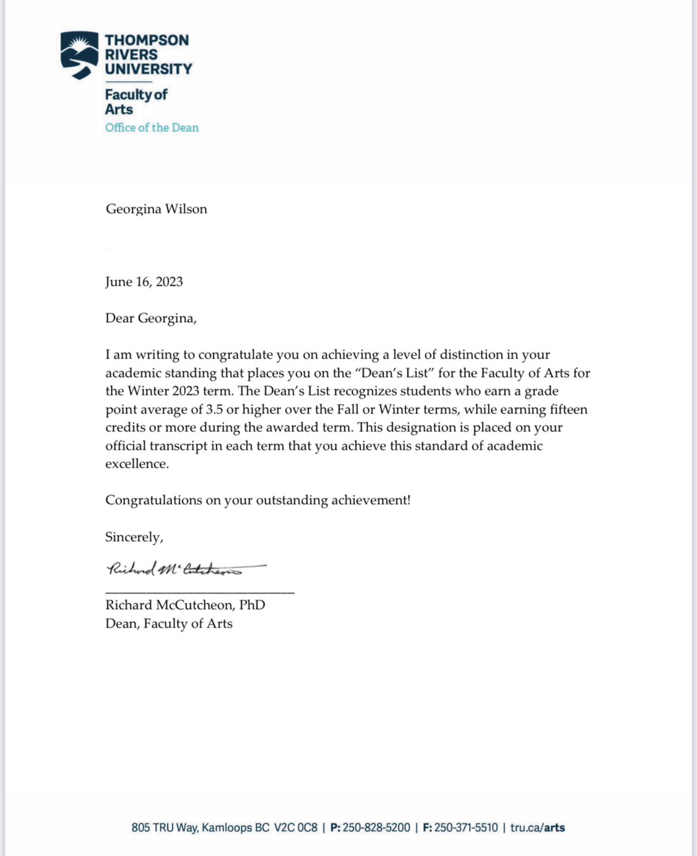
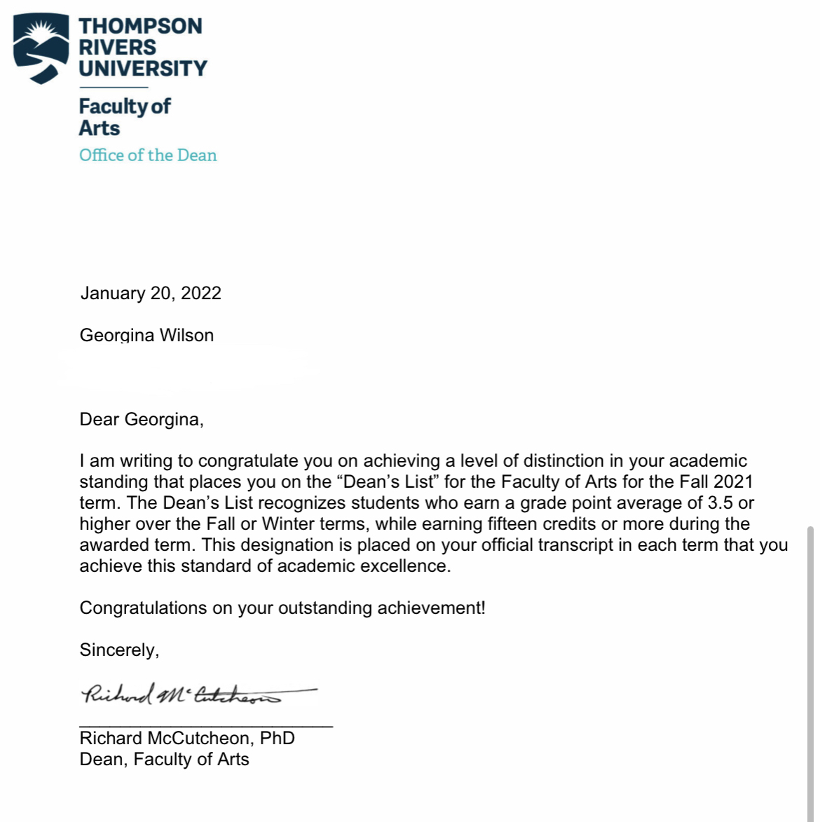

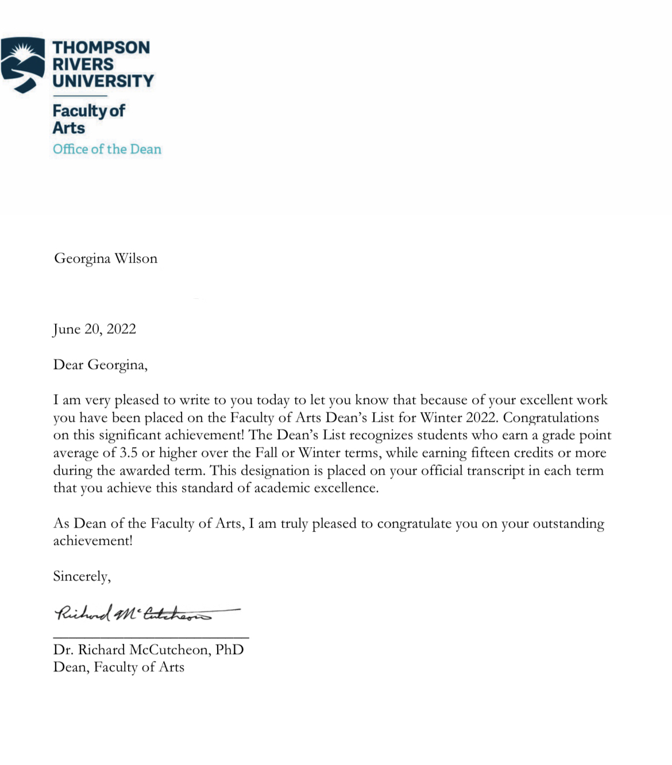
Thompson Rivers University
From a struggling student barely passing in Elementary and High School to excelling in University.
These experiences will make me a strong teacher.

Slide 15
Thank You!

